Slide 1
GeOceanographers
Mary, Colin, Ellie, and Arya

Slide 2
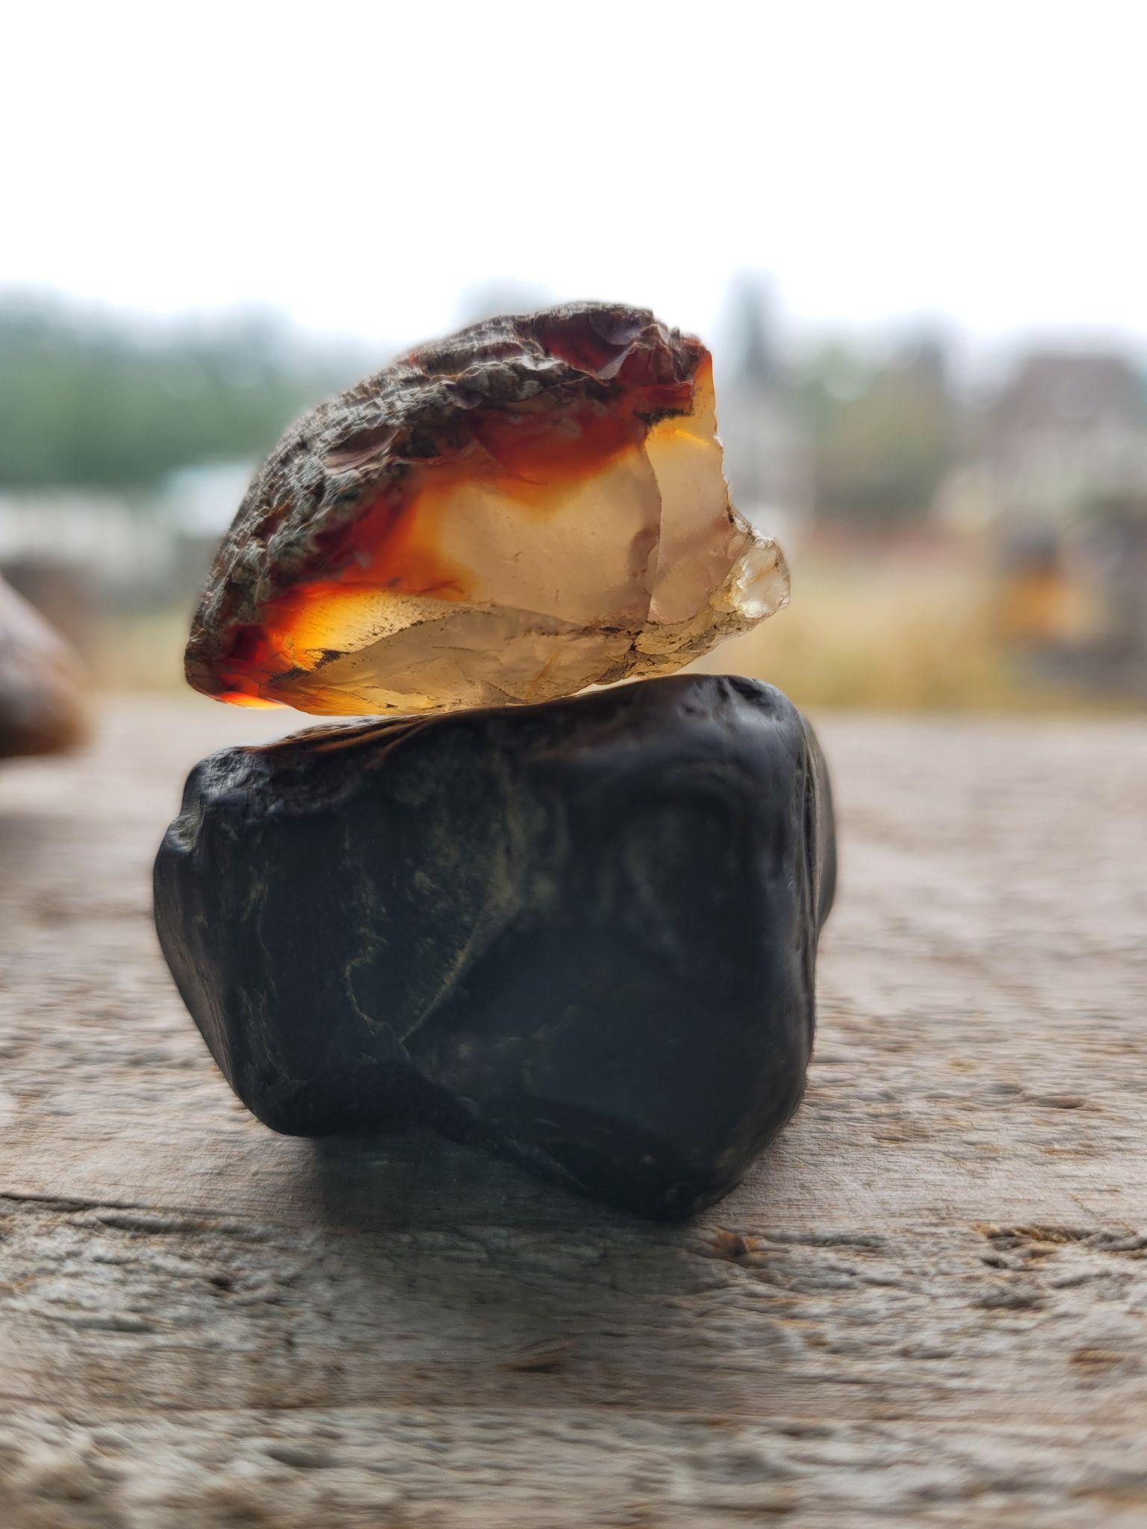
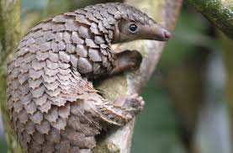
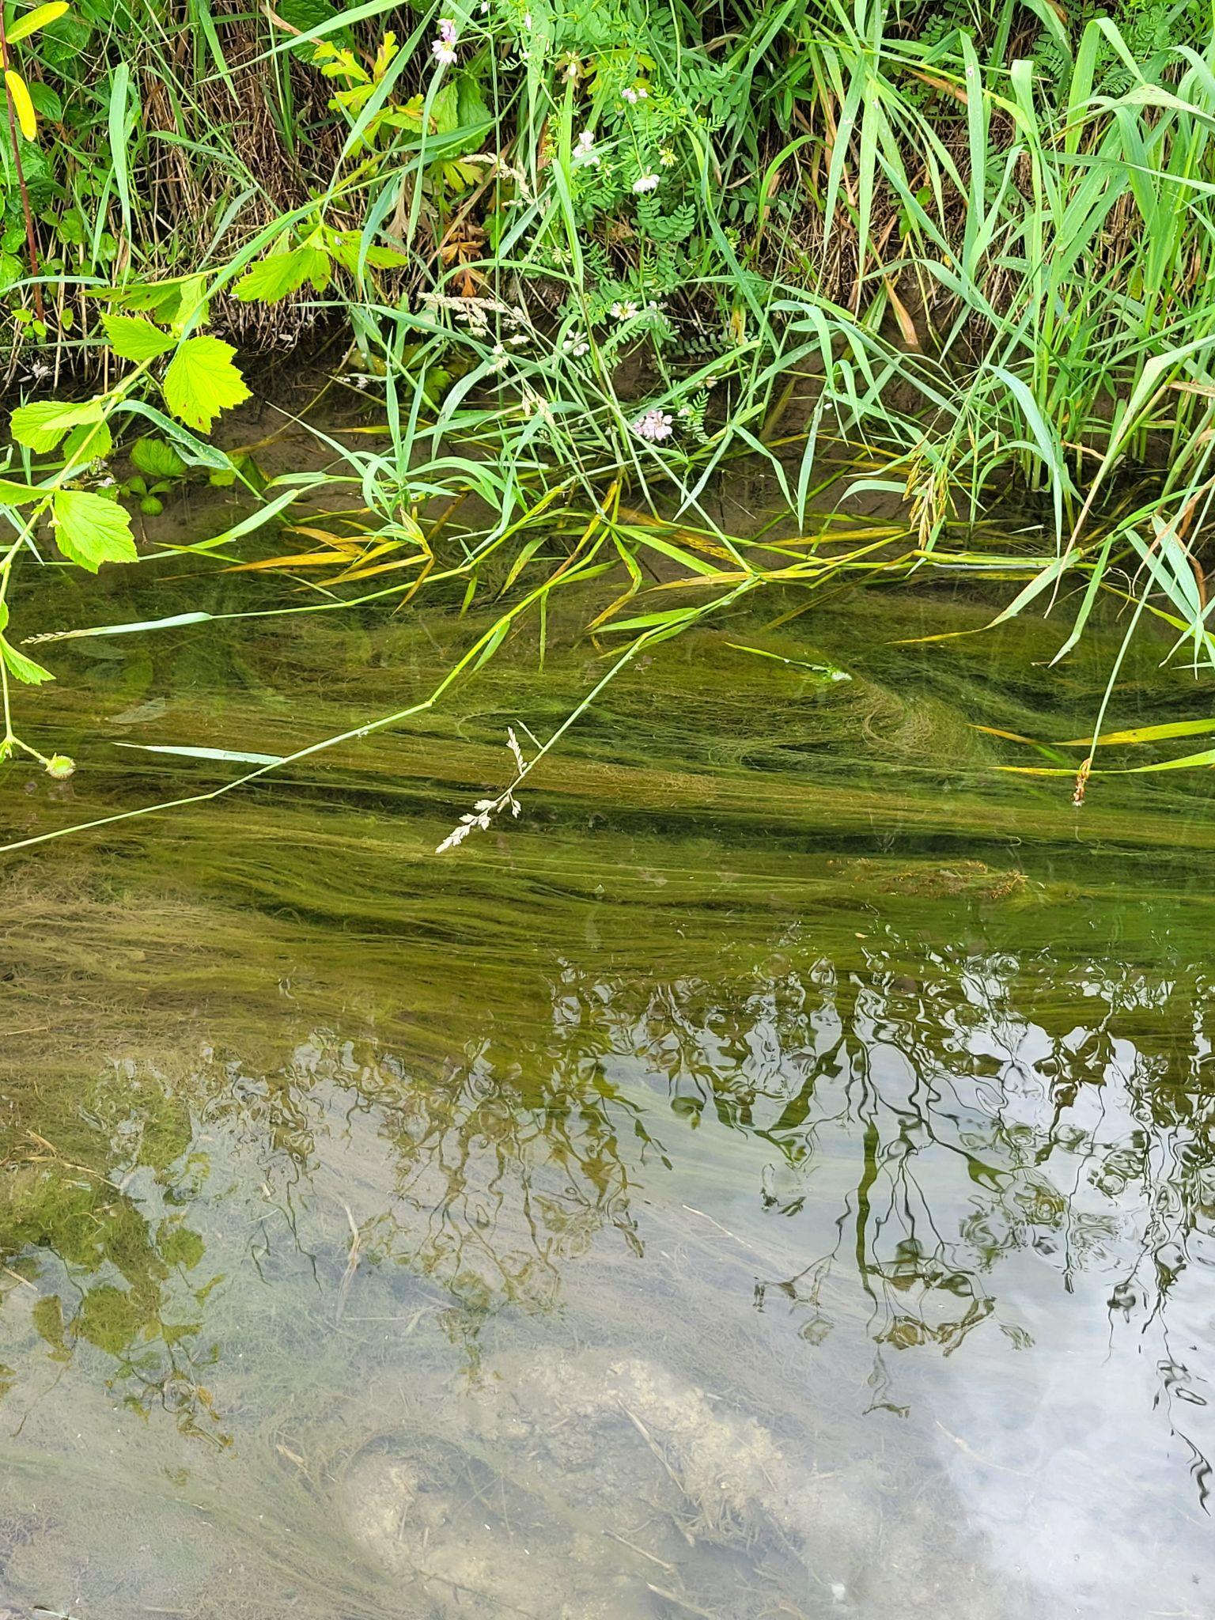
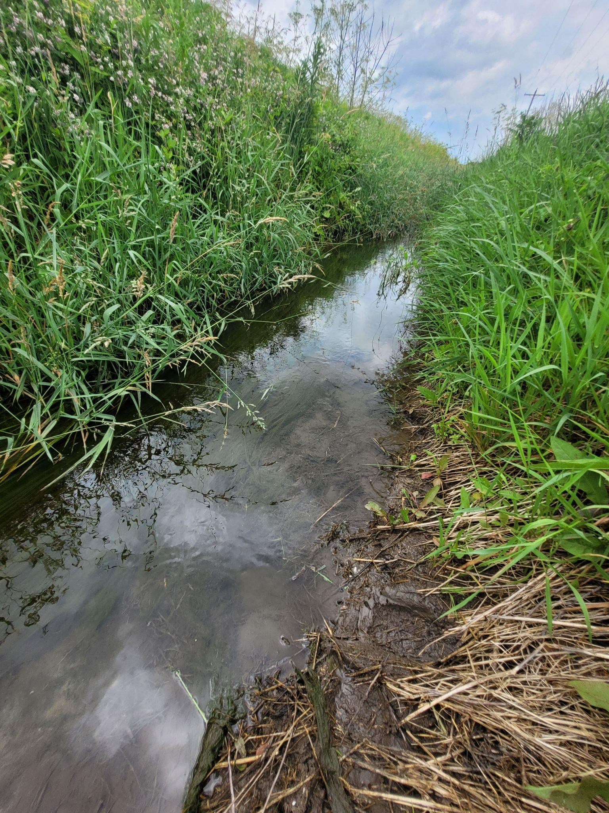
Mary Orrand
Background Expertise
-Geochemistry and Hydrology
-Environmental Forensics using radiogenic and stable isotopes
-Carbon capture technologies, namely enhanced rock weathering
-Carbon cycling in river systems
-Coastal hazards
-Field data collection, interpretation and analysis
-Interdisciplinary research and communication
-Rockhounding!

Slide 3
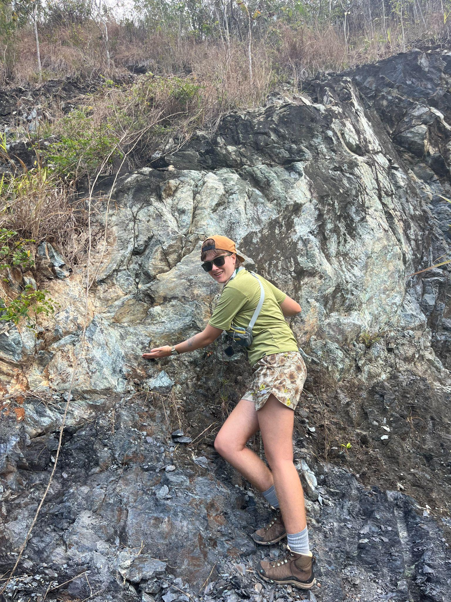
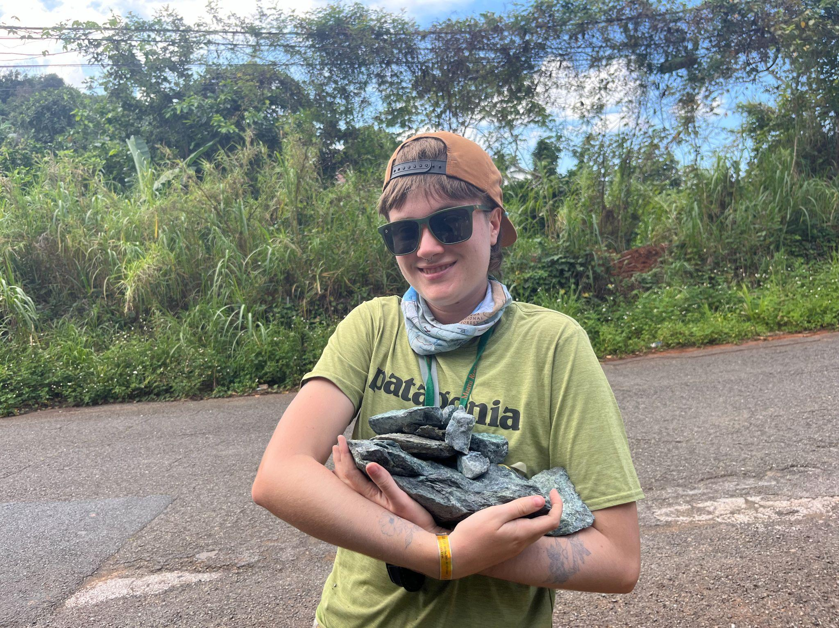
Ellie Barkyoumb
Bachelor of Science in Marine Science & Geology from the University of Miami
Sedimentology of modern carbonate systems (Florida Keys, Bahamas, Red Sea)
Also developed interests in geochemistry!
First year PhD student in Oceanography @ UW
Marine carbon dioxide removal (mCDR) through mineral carbonation (in subseafloor basalts)
Fluid flow and chemical fluxes at subduction zones
General interests: geohazards, climate change mitigation, and marine geochemistry

Slide 4
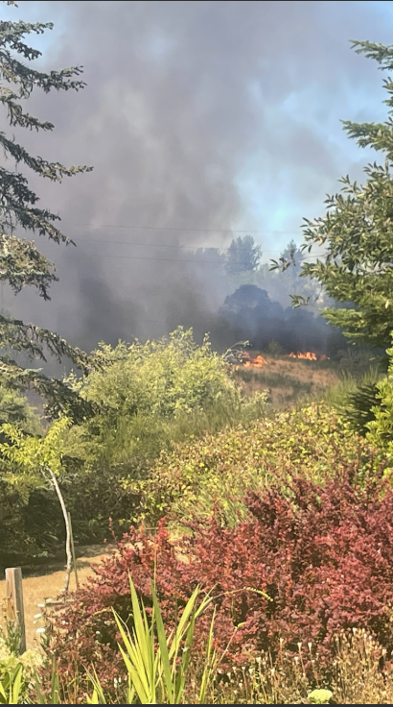
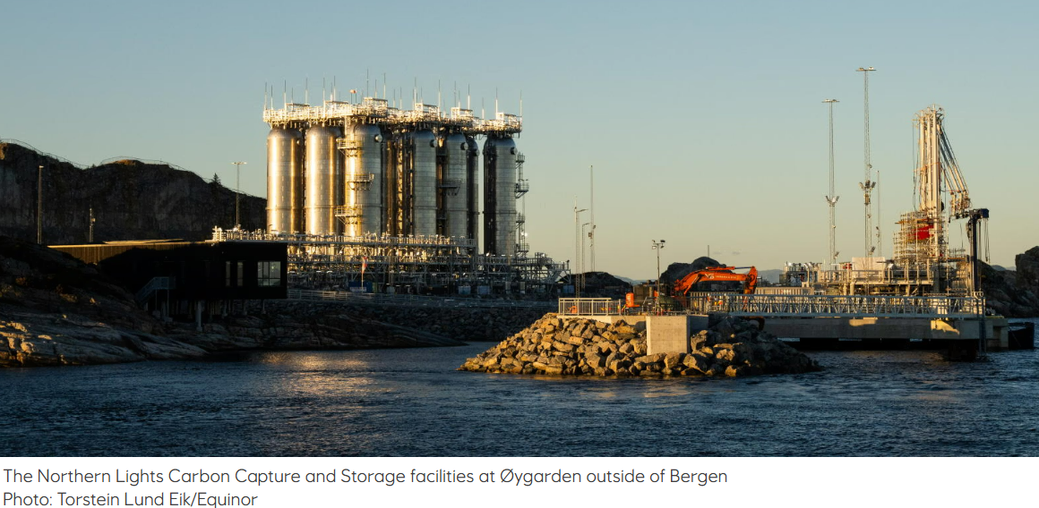
Colin Watson
Undergraduate in Geoscience
Some experience with GIS
General interests in climate change mitigation and point source carbon capture.

Slide 5
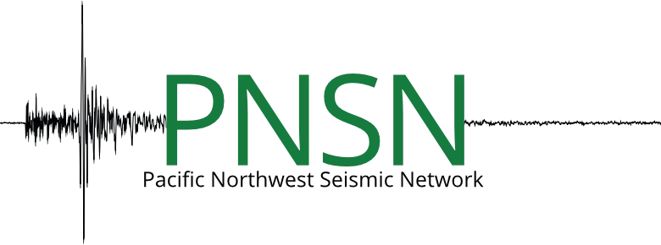
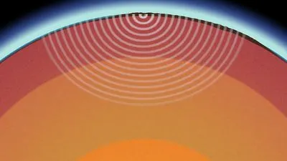
Arya Ranu
Escaped ECE! Undergraduate in Geology, minor in Mathematics
Interest in Seismology, DSP in the geosciences, ML/CNN for seismic risk modeling
Current PNSN employee

Slide 6
Questions/ Topics of Interest
Main Topic of Interest:
Can machine learning help to identify how warming oceans and climate change influence carbon cycling in coastal waters (carbon uptake versus release)? How do related chemical variables like temperature, pH, dissolved oxygen, and alkalinity interact and influence carbon storage, and how is this expected to change spatially or temporally?
Back up question (If above topic is not looking feasible):
Can ML identify environmental conditions that contribute the most to coastal landslides and bluff failure in Washington (rainfall patterns, duration of storm events, slope/elevation of land features, hard armoring vs natural armoring, sediment input, etc?)

Slide 7
Why are These Topics Interesting?
Coastal Carbon Cycles:
Ocean serves as really important carbon sink for the planet
Climate regulation is heavily influenced by carbon cycle
Warming oceans will change carbon chemistry through thermodynamics
Marine species are impacted by these changes
Will these changes contribute towards a negative feedback loop with global warming?
Can machine learning help identify trends, relationships, and contribute towards climate predictions?

Slide 8
Sources and Basic Metadata
National Oceanic and Atmospheric Administration NOAA & National Centers for Environmental Information (NCEI)
High-resolution ocean and atmosphere pCO2 time-series measurements from mooring Dabob_122W_48N in the Puget Sound
Time Period: June, 10, 2011 - November, 5, 2021
Buoy Position: Dabob Bay 47.80°N, 122.80°W
Equipment: MAPCO2® buoy
Measurements:
sea surface salinity
pCO2 in atmosphere and water
Water temperature
NOAA Merged Land Ocean Global Surface Temperature Analysis
Average of sea-surface temperature and land surface temperature on month-long timescales in a gridded format (LAT, LONG)
Also available as yearly time series for different grids
Correlate with pCO2 data
Sutton, Adrienne J.; Sabine, Christopher L.; Newton, Jan; Mickett, John; Musielewicz, Sylvia; Maenner Jones, Stacy; Dietrich, Colin; Bott, Randy; Osborne, John (2014). High-resolution ocean and atmosphere pCO2 time-series measurements from mooring Dabob_122W_48N in the Puget Sound (coastal Washington) (NCEI Accession 0116715). [indicate subset used]. NOAA National Centers for Environmental Information. Dataset. https://doi.org/10.3334/cdiac/otg.tsm_dabob_122w_478n. Accessed 1/22/2026.

Slide 9
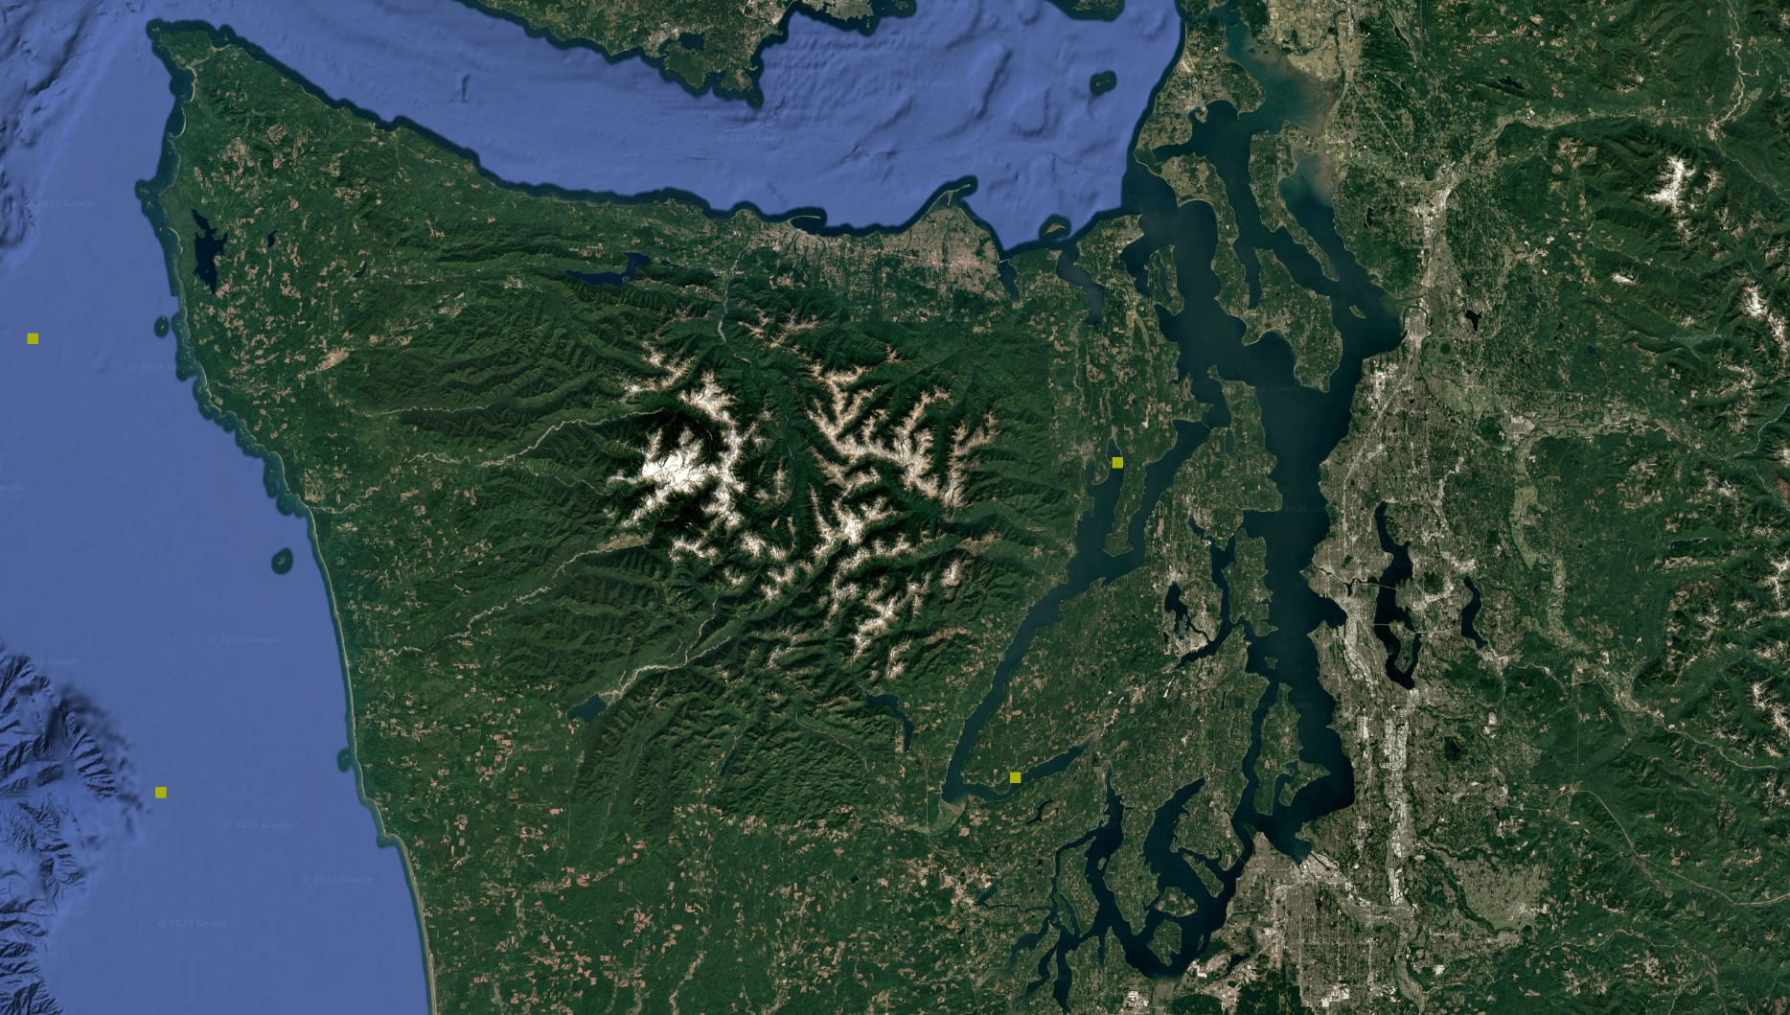
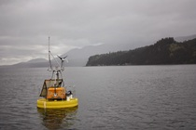
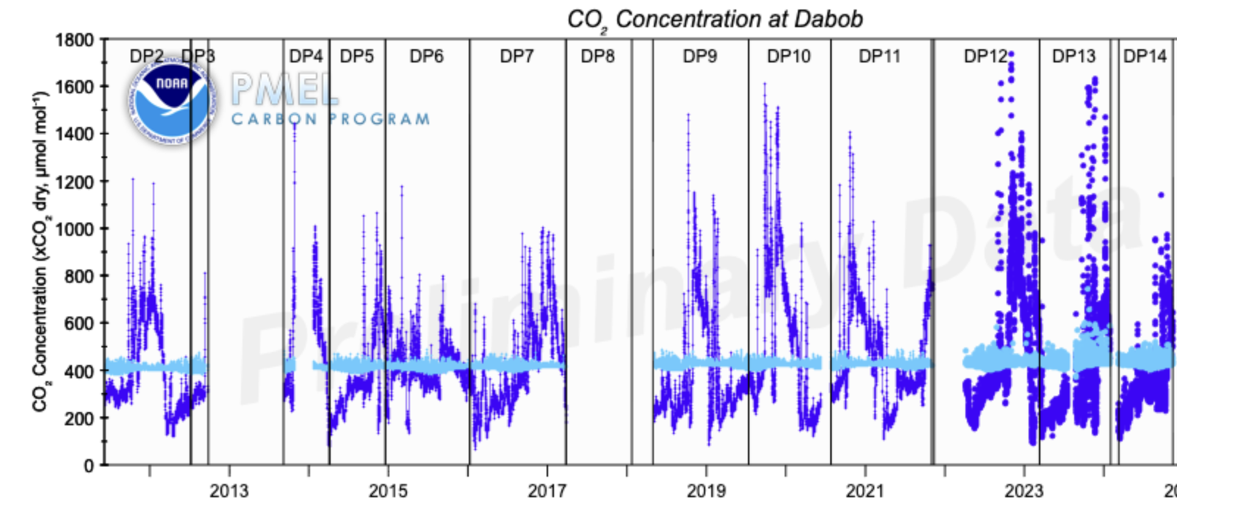
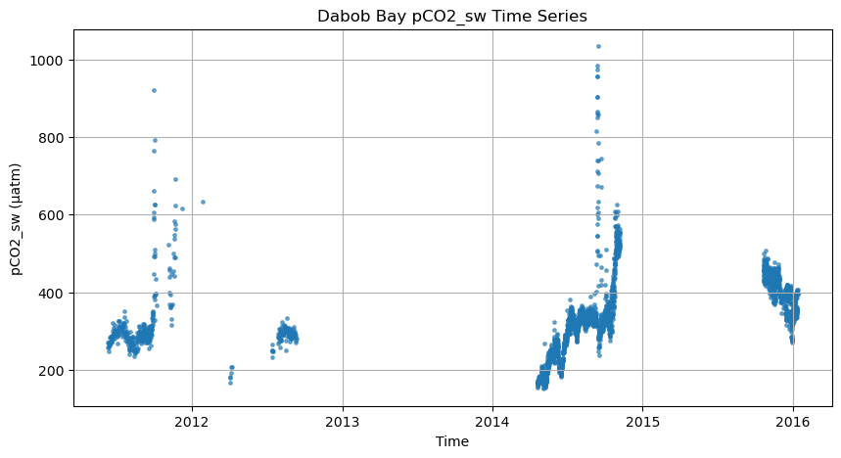
Preliminary Characteristics and Visualizations
Moorings provide real time field observations, and direct measurements of pCO₂
Drawbacks/Issues:
-not fully continuous because of seasonal deployments
-lack of continuity of instrumentation between moorings and deployment seasons
-no pH or other carbonate species (possible incorporation of PyCO₂SYS)
PMEL Carbon Program

Slide 10

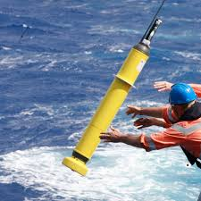
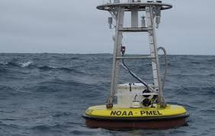

Potential Future Directions With Data Acquisition
Depending on the region/geographic context that will work for our project, different approaches and datasets can be utilized
Global
Local

Slide 11
Links to explore (in progress)
Climatology:
https://www.ncei.noaa.gov/products/northeast-pacific-regional-climatology
Ocean chemistry:
https://www.ncei.noaa.gov/products/ocean-chemistry
https://data.noaa.gov/onestop/collections/details/69de57c2-1a86-4487-a73f-efd9c963079e
For presentation 1:
NOAA PMEL Carbon Program Interactive Search Module:
https://www.pmel.noaa.gov/co2/story/CO2%20Data%20Discovery
ERDAPP Usage Instructions:
https://data.pmel.noaa.gov/socat/erddap/rest.html
Information on socat (surface ocean co2 atlas)
https://www.pmel.noaa.gov/co2/story/SOCAT
NASA Ocean Color (MODIS, SST, ocean surface temperature)
https://oceandata.sci.gsfc.nasa.gov/l3/

